Slide 1
Capstone 2
File created on: 7/5/2020 11:48:48 AM

Slide 2
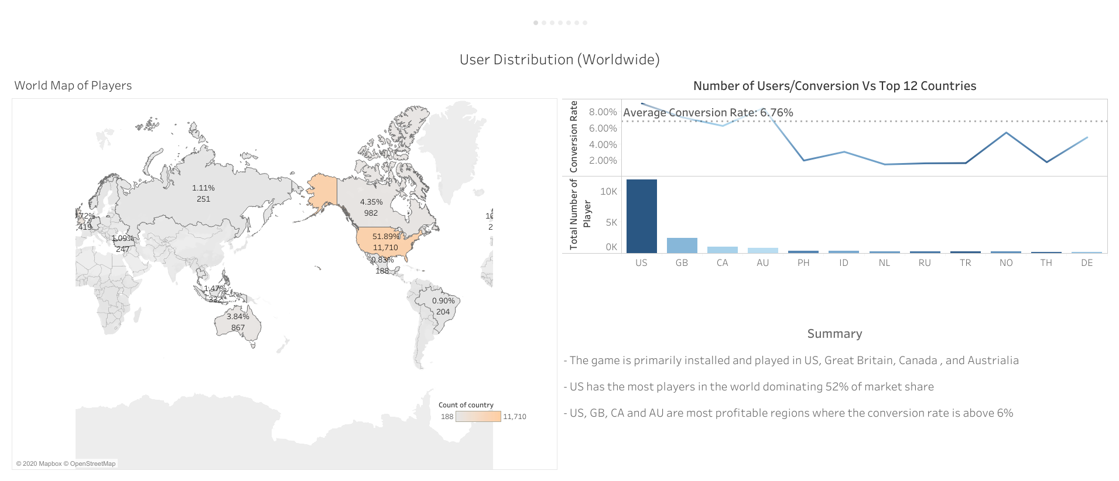

Slide 3
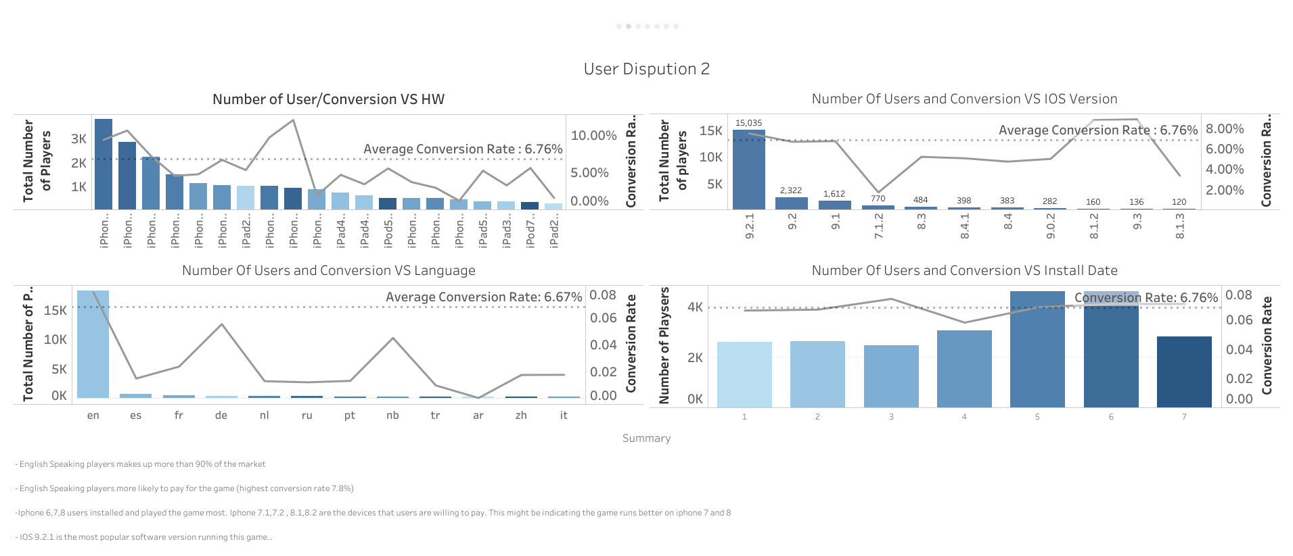

Slide 4
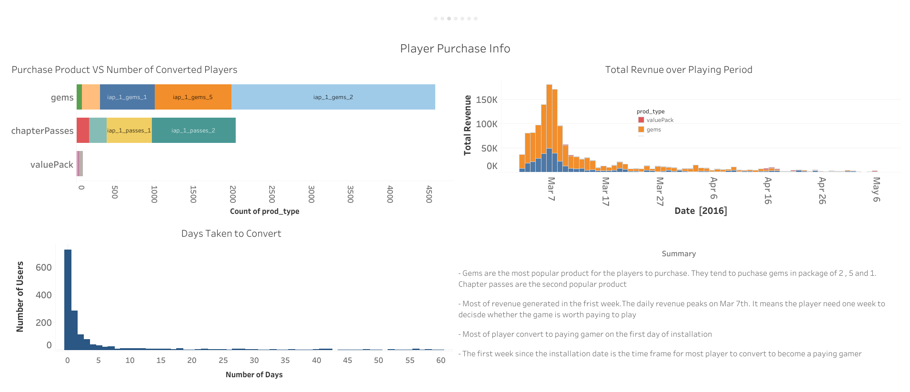

Slide 5
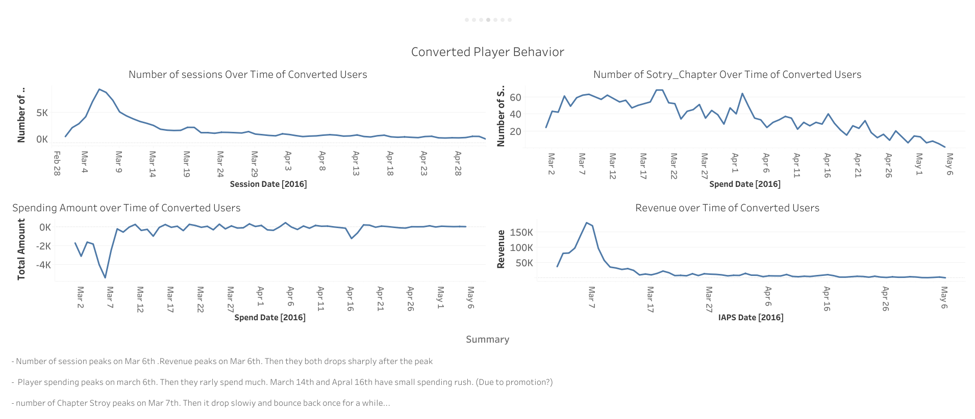

Slide 6
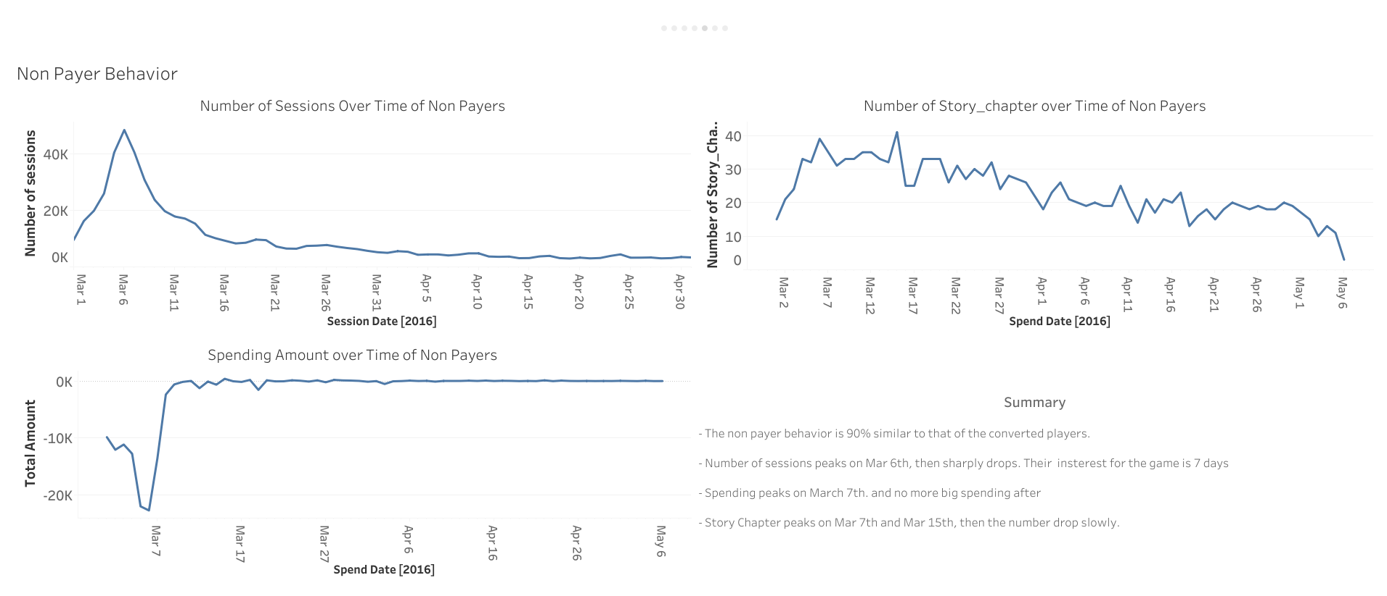

Slide 7
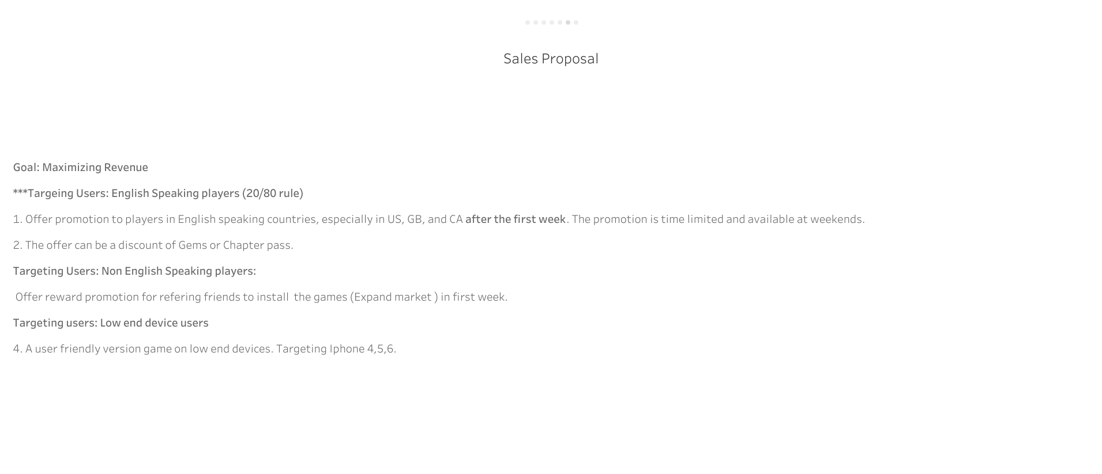

Slide 8
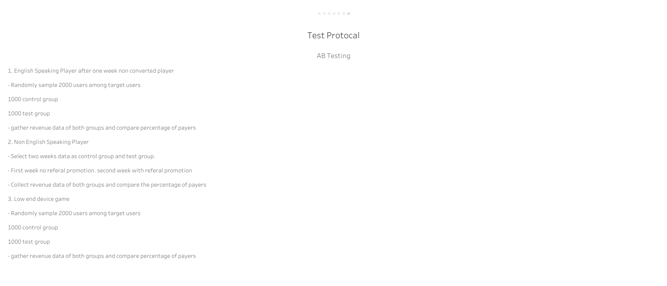

Slide 9
Data Modeling – Data preparation
KPIs
Language, Country, HW_ver, OS_ver, rev_sum, sessions, amount, story_chapter, level
Total coverted User : 927, Total Non payer :12278 unbalance
Mix sampling method to balance data
Total converted Users: 13276, Converted Users:13134

Slide 10
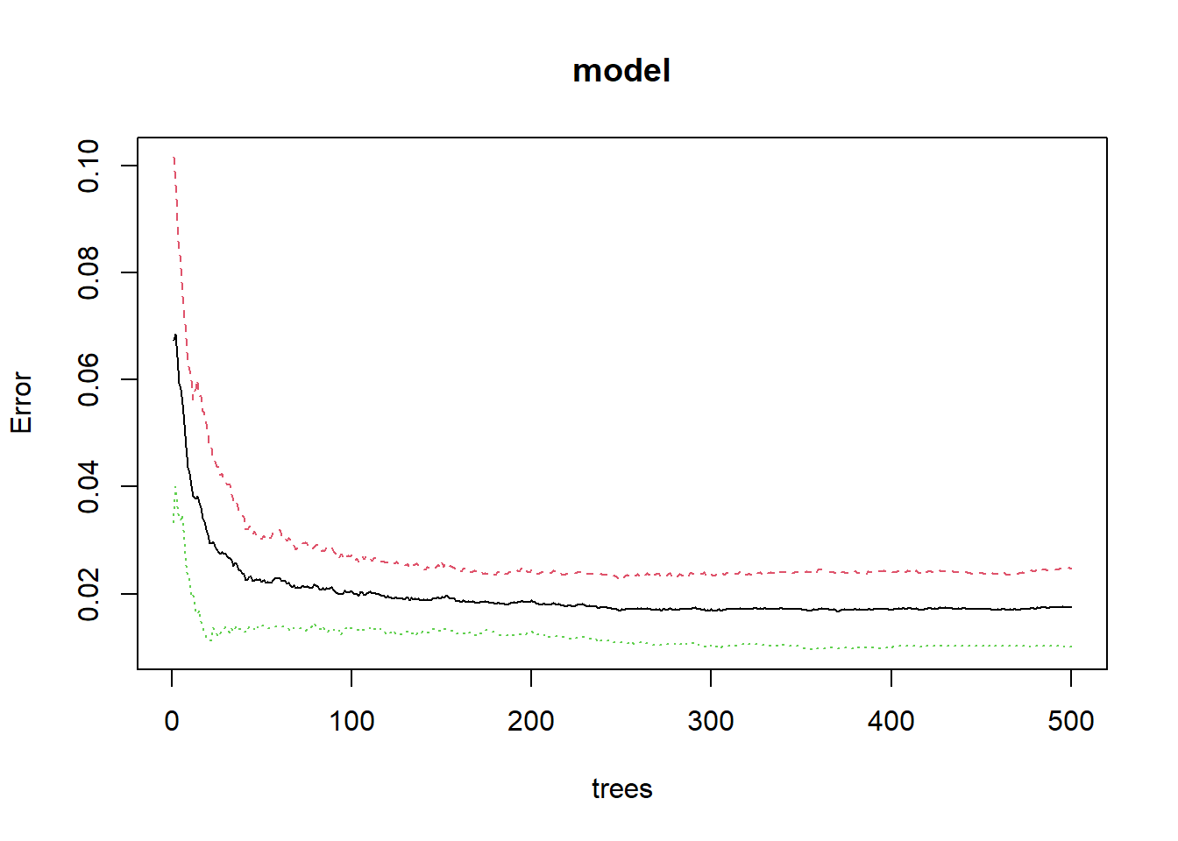
Data Modeling – Random Forest
Train test split ratio: 0.75
OOB error < 0.02 after 500 trees training
TPR 45.0% TNR:94.7 Accuracy: 91.3%
Confusion Matrix
Actual
Predicted Converted Non Payer
Converted Users 139 214
Non payer 170 3878

Slide 11
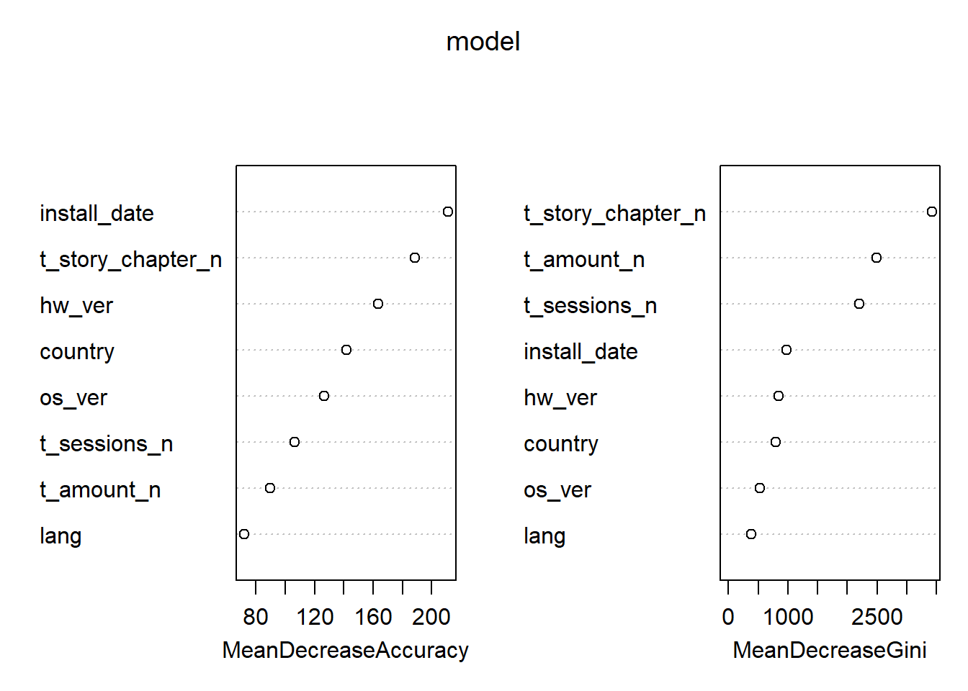
Data Modelling – Random Forest
Top KPIs:
Mean decrease Gini
Story_chapters
Amount
Sessions
Mean Decrease Accuracy
Install date
Story chapters
Hw_ver

Slide 12
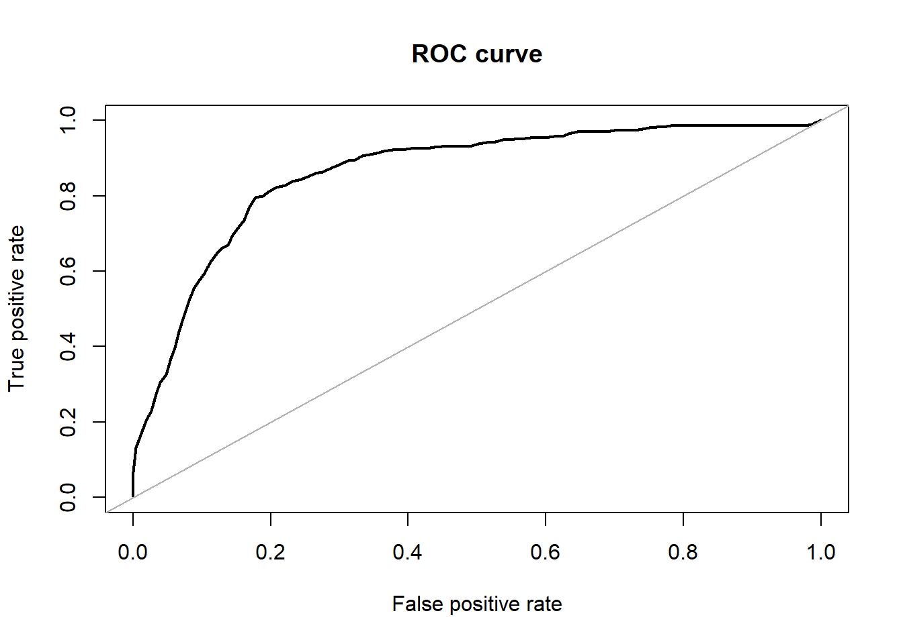
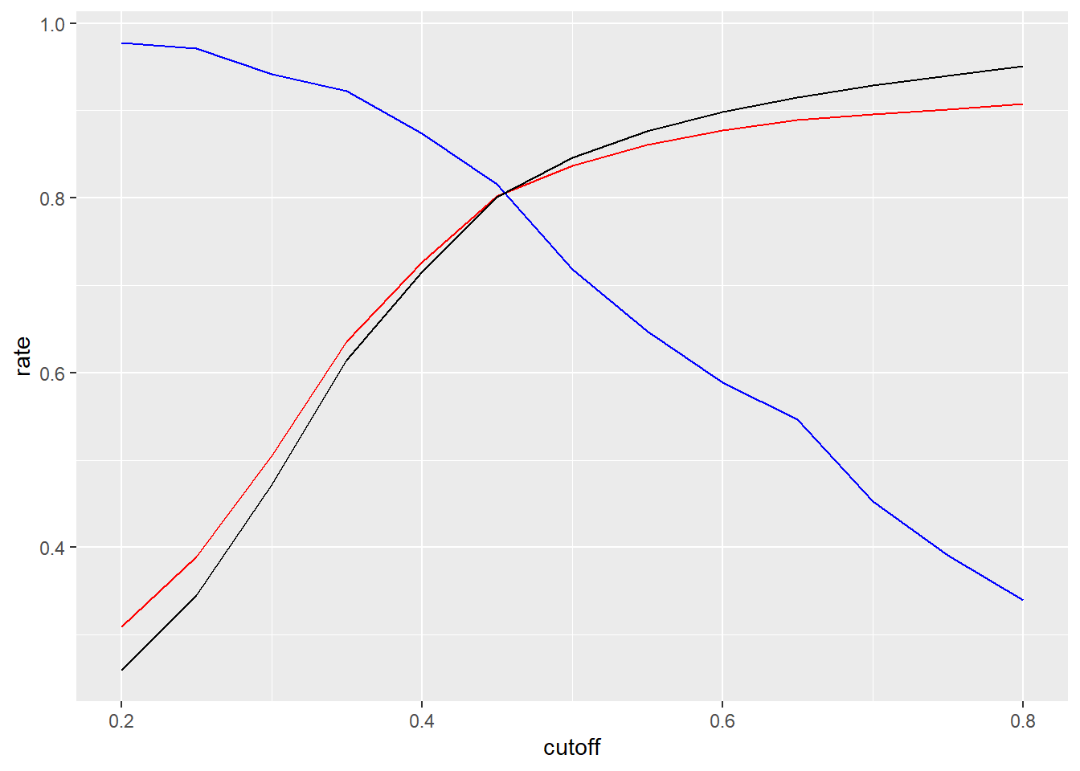
Data modeling – Logistic Regression
Train test split ratio: 0.75
TPR 79.6% TNR:82.3 Accuracy: 82.1%
Confusion Matrix
Actual
Predicted Converted Non Payer
Converted Users 246 725
Non payer 63 3367

Slide 13
Data modelling – Logistic Regression
Key KPIs
All KPIs plays important role
Story_chapter, sessions, country and installation date are staticstically significant

